Slide 1
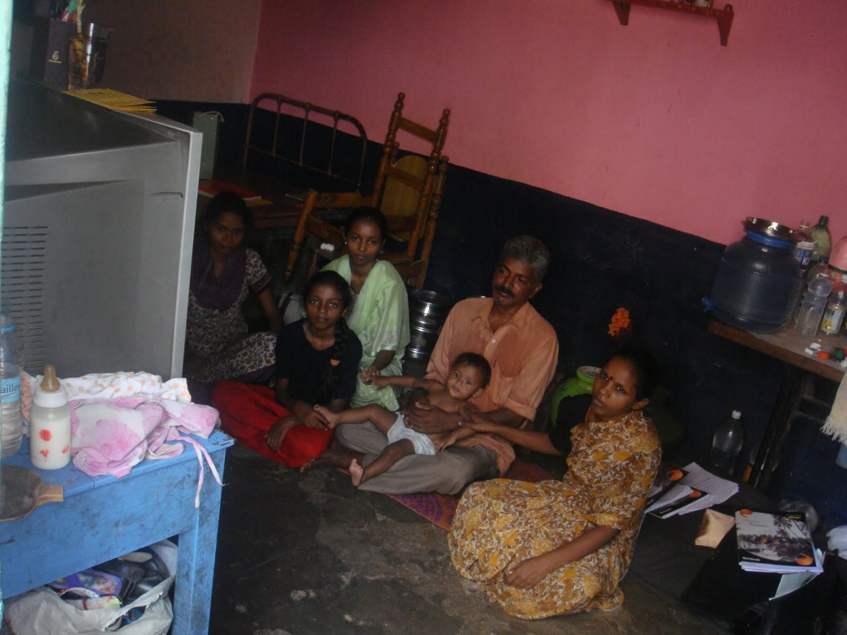
“HOUSEHOLD BC”
June, 2010
Bangalore
RESEARCH
TEAM
Aliya Pabani
Tanvi Srivastava
Alisha Panjwani

Slide 2
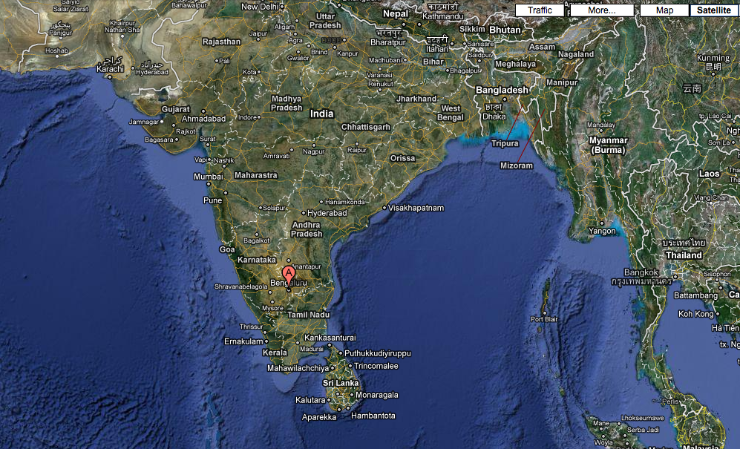
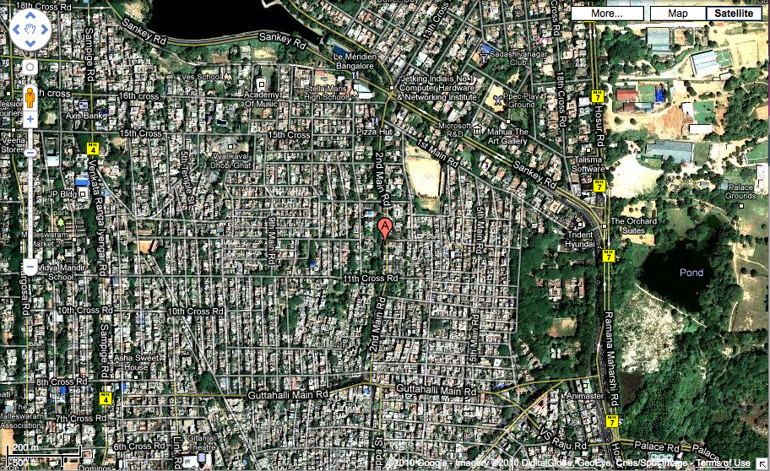
Karnataka, India
Population of India:
Average Income:
Population of Karnataka:
Average Income:
urban, mixed income neighborhood
near the city center
government housing

Slide 3
Bangalore
notable facts, blah blah blah
urban, mixed income neighborhood
near the city center
government housing

Slide 4
VAYALIKAVAL
near the city center

Slide 5
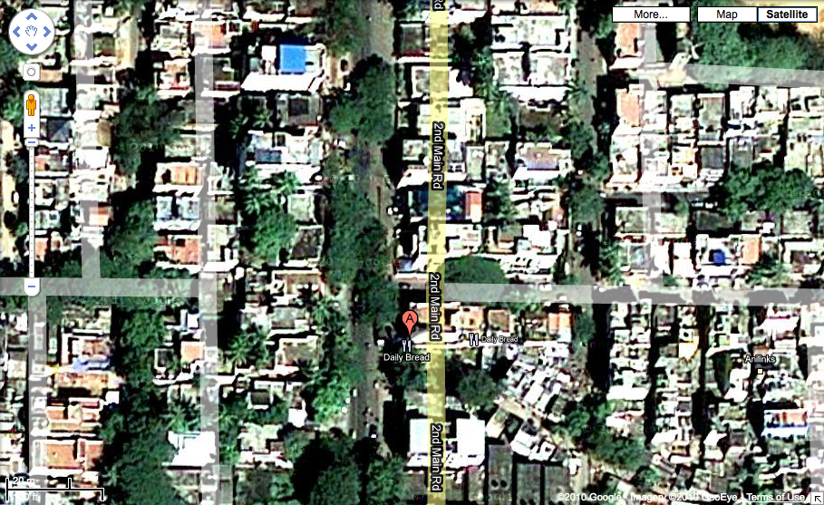
VAYALIKAVAL
urban, mixed income neighborhood

Slide 6
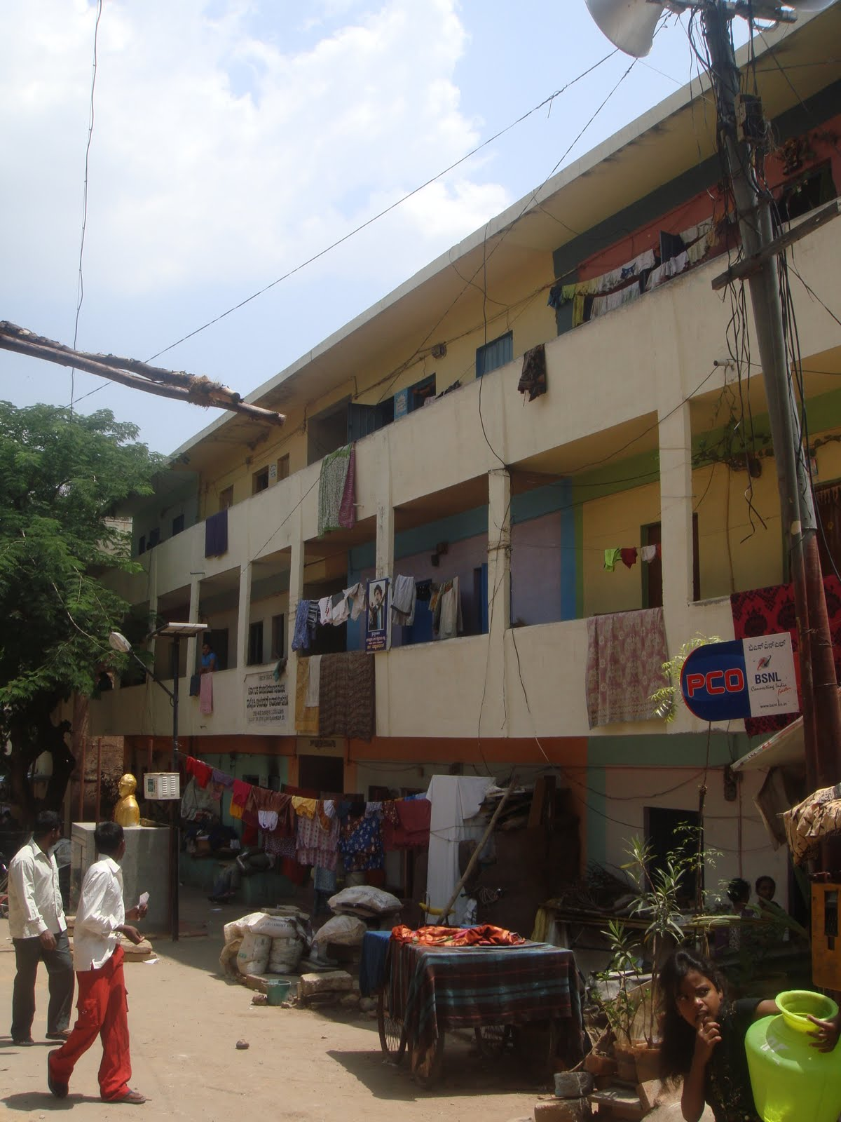
<Information about the local block>
government housing
They live here

Slide 7
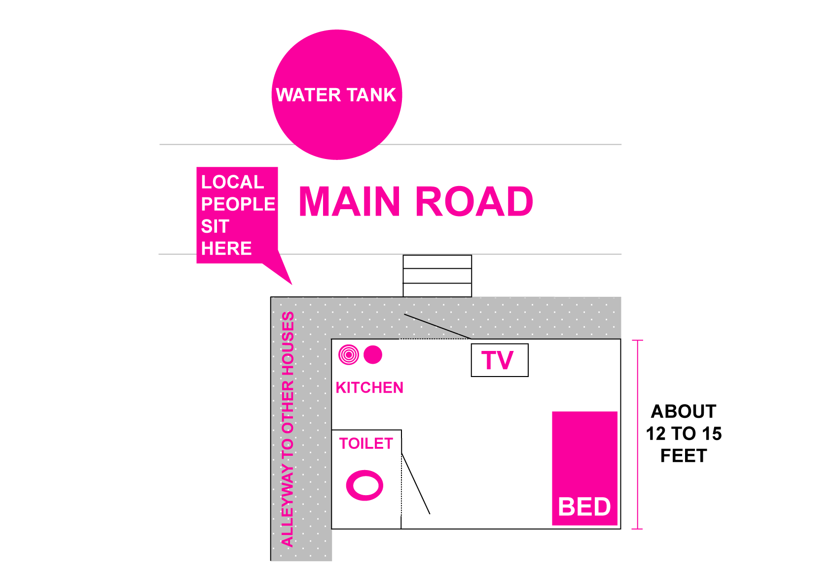
HOUSEHOLD SCHEMATIC

Slide 8
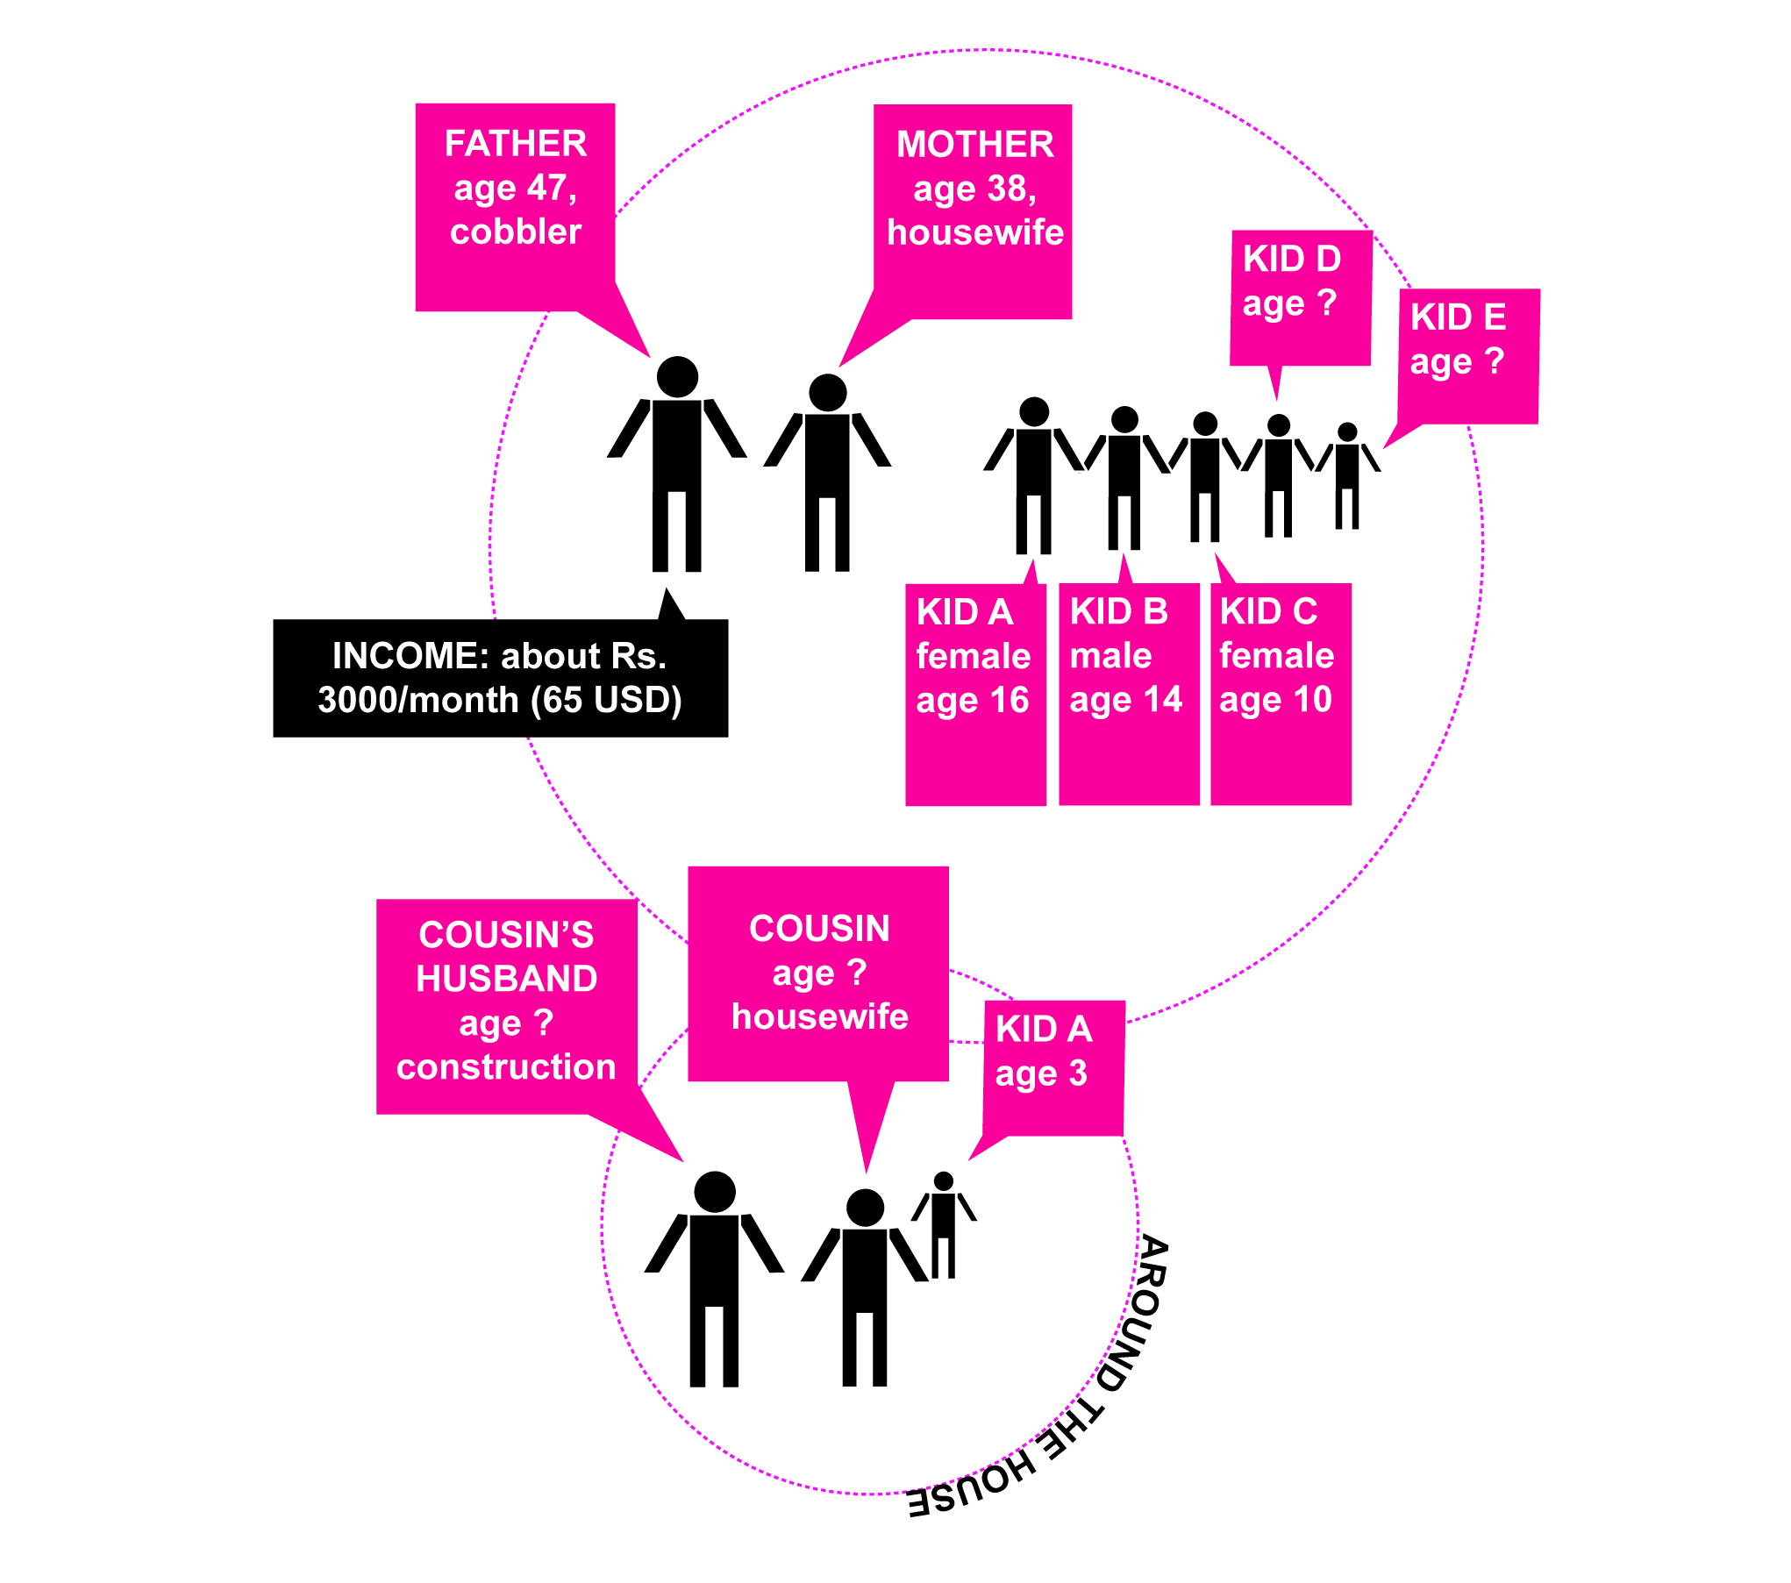
SOCIAL
SCHEMATIC

Slide 10
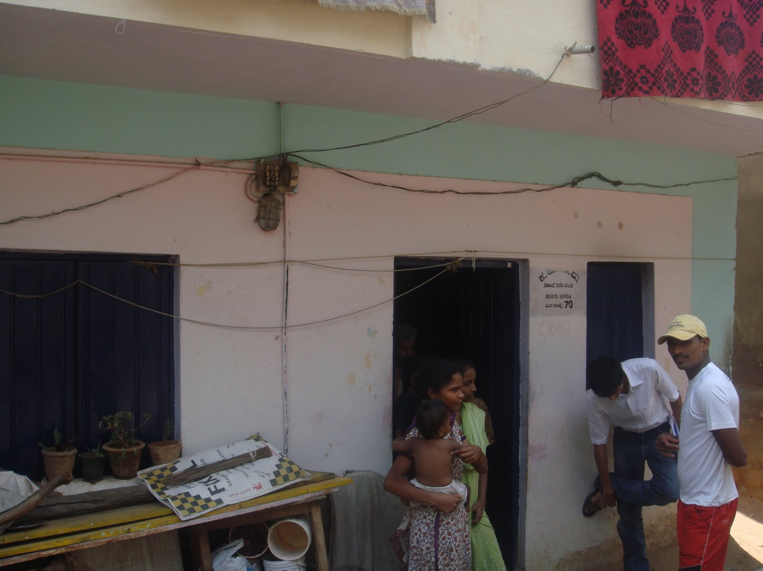

Slide 11
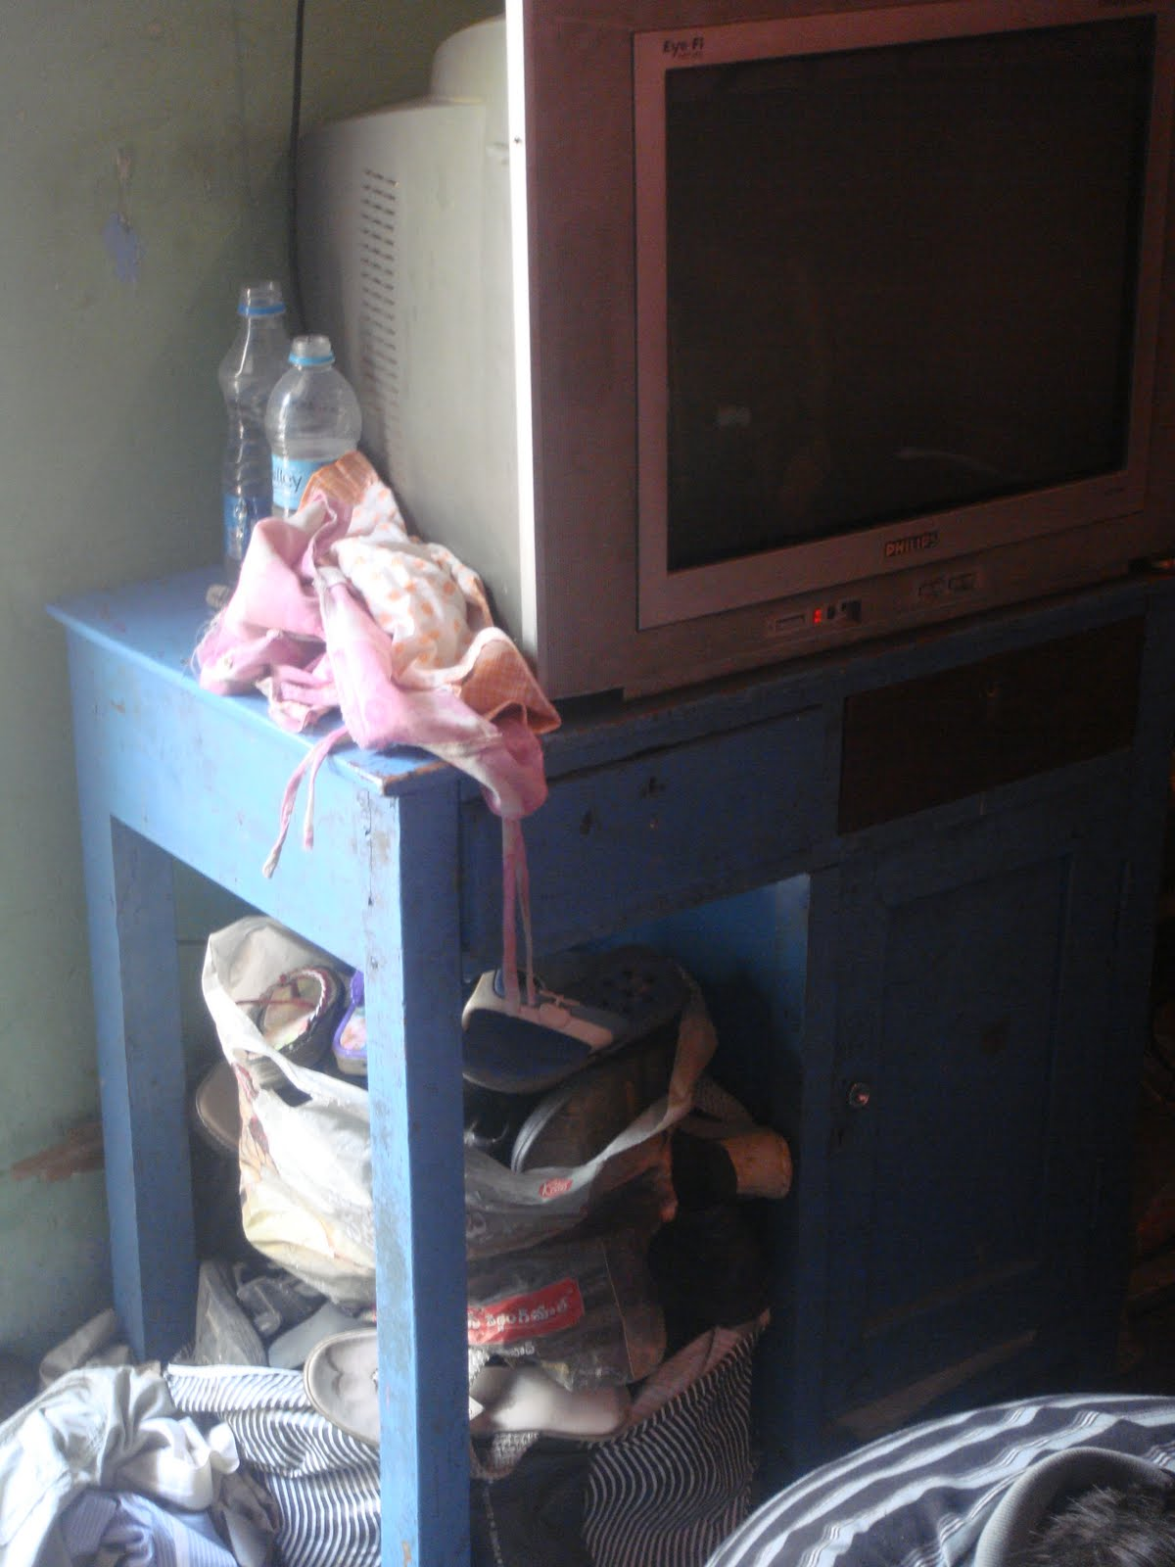
TECHNOLOGIES IN THE HOME
TV: Rs. 9000, 2 years old
Sewing machine
Radio
Electric fans: don’t use them because they consume too much electricity
Phone: no mobile, they use the “PCO” phone (coin deposit phone at the shop outside the house)

Slide 12
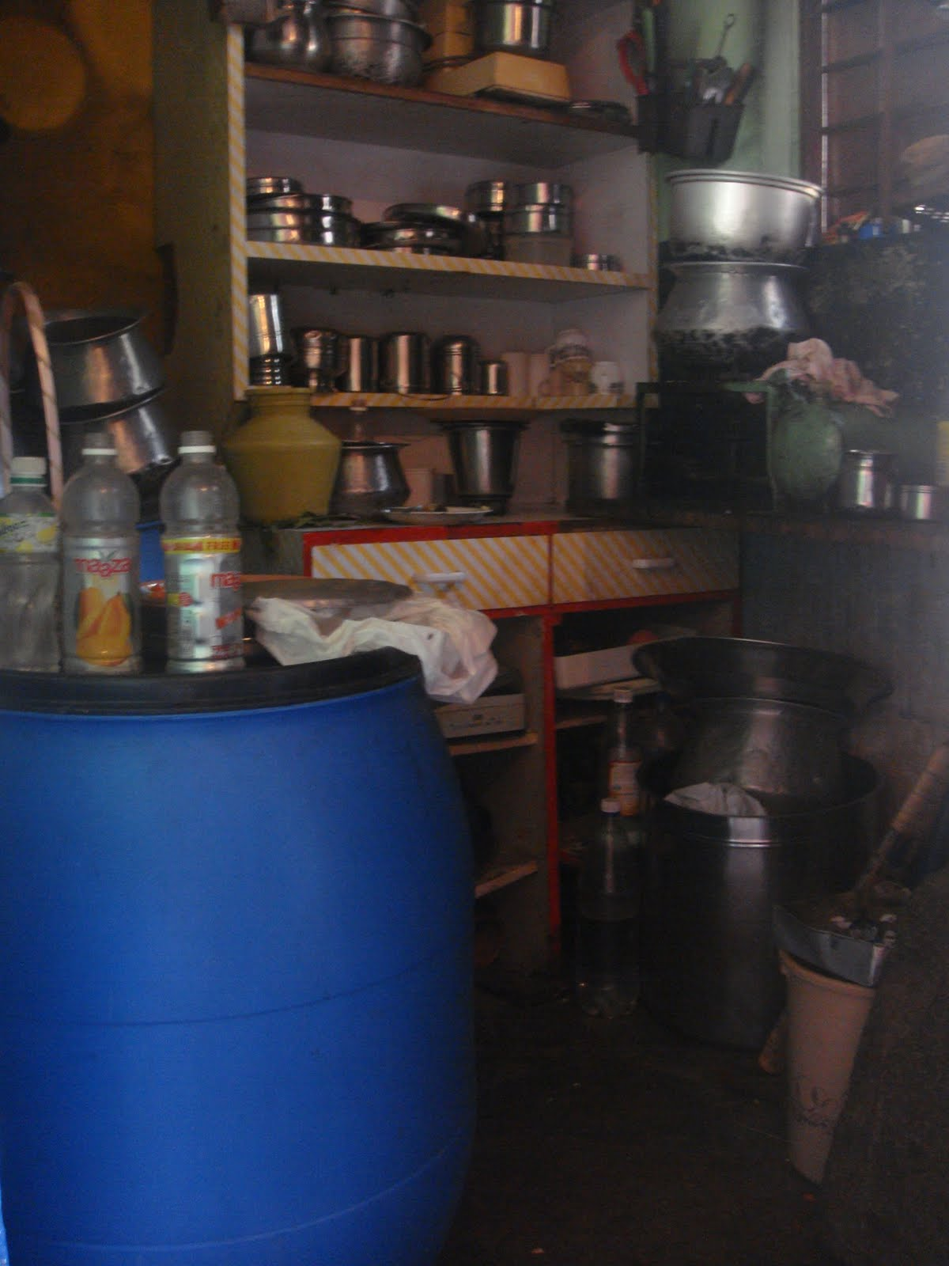
THIS IS THE KITCHEN…
There is no light bulb in the socket above it…they only keep one light source in the house on at a time--one zero watt bulb.
The blue barrel is full of water: the city supplies water every second day, so a fair bit of the household is covered in water containers, from bottles to basins
Most of these families own many, many cooking vessels and dishes

Slide 13
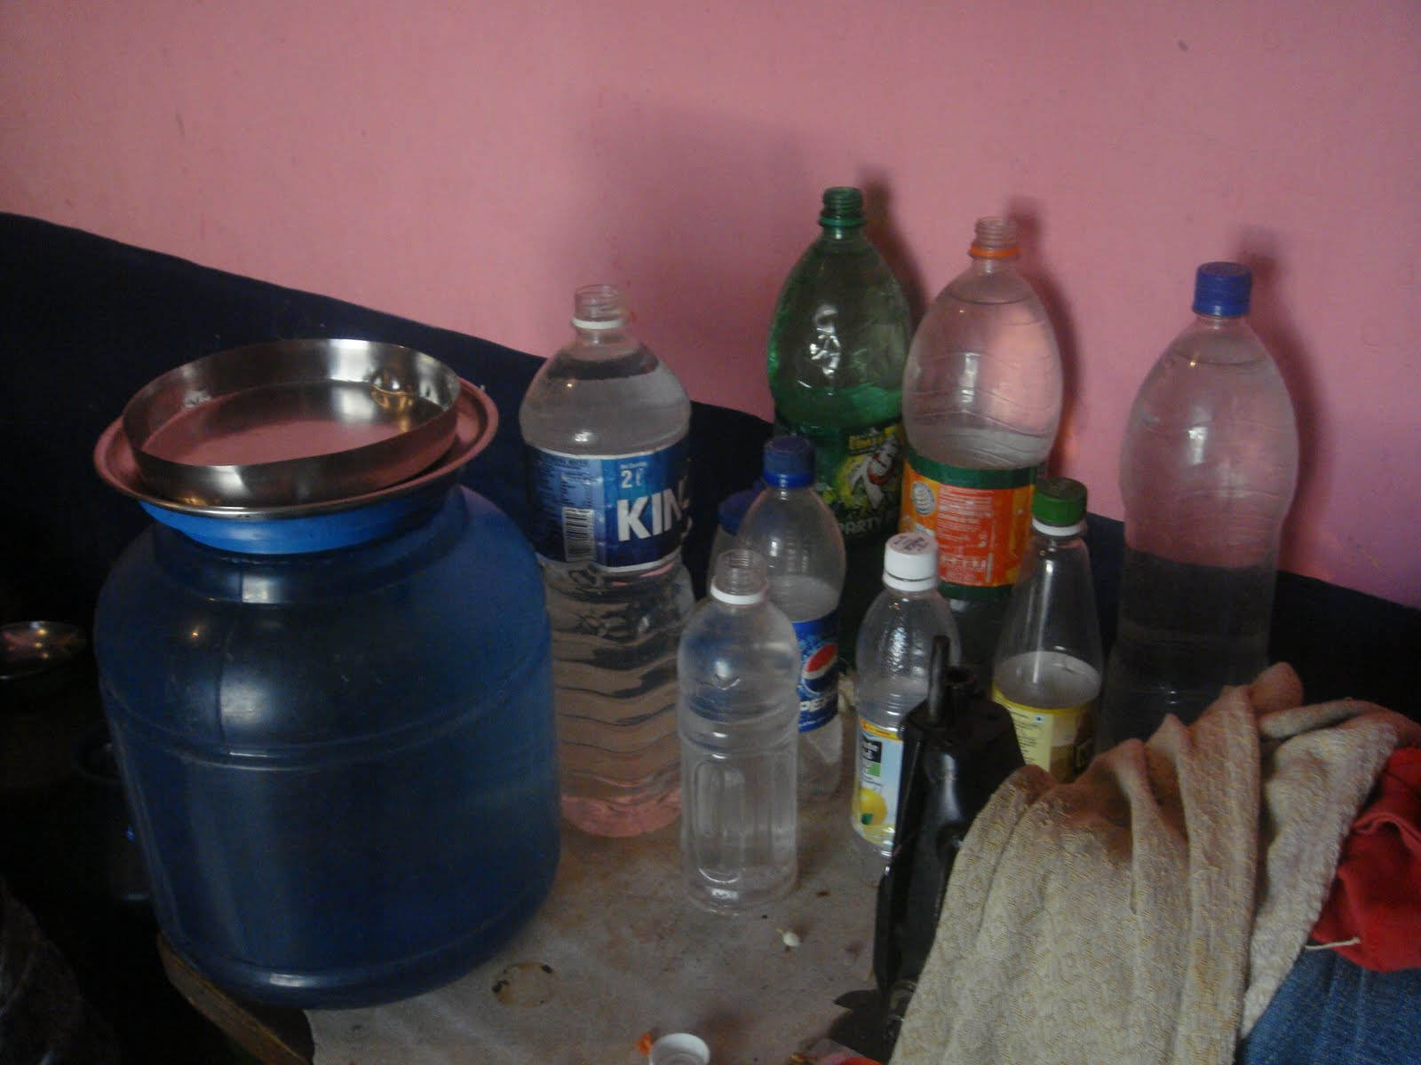
Re-used water bottles

Slide 14
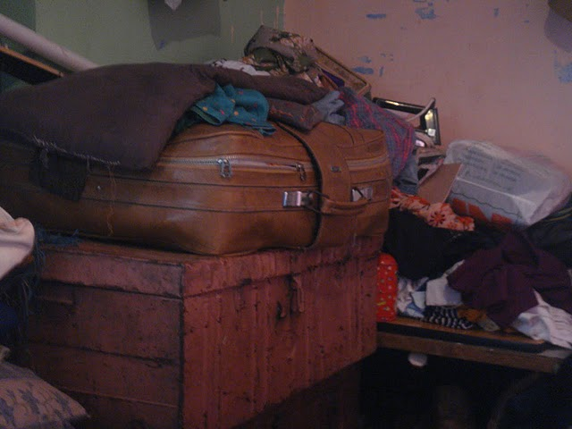
Most of their belongings are stowed away when not in use, including clothing, toys, vessels and fans…

Slide 15
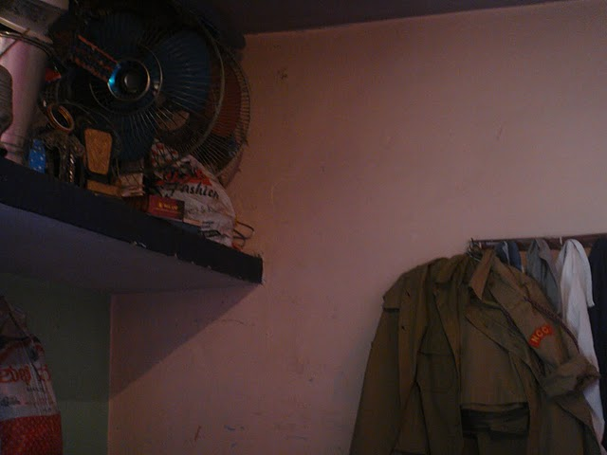
The son’s cadet uniform is hung prominently in the otherwise spare room, indicating the importance given to both the son and his hobbies. Many of the houses of this income level had cadet certificates and uniforms hung in the main room.

Slide 16
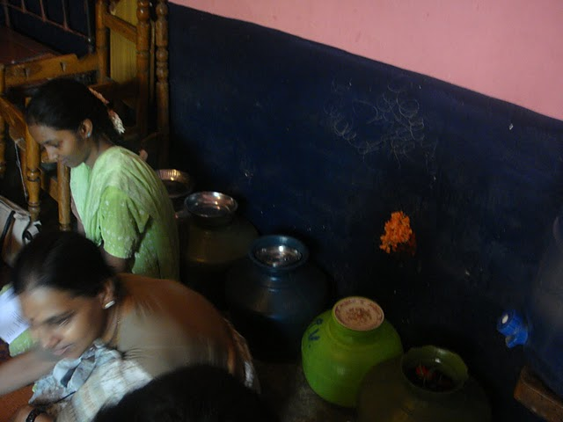
More water storage vessels…

Slide 17
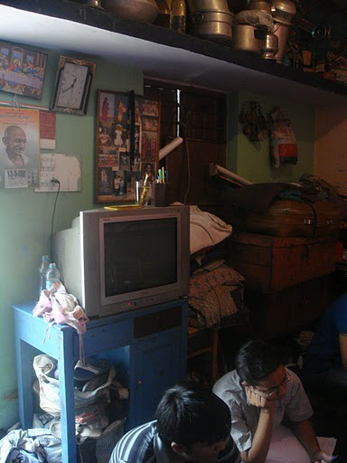
IN THE TOP LEFT CORNER, THERE’S A PICTURE OF JESUS’ LAST SUPPER…
It’s actually pretty common to find Christian paraphernalia in many Hindu homes, especially since there are many mixed marriages and conversions in this income group.
In this household, the mother’s sister converted to Christianity, and gave it to them as a gift. The children go to a convent school, and so they sometimes enjoy lighting candles and praying. The parents don’t mind.

Slide 18
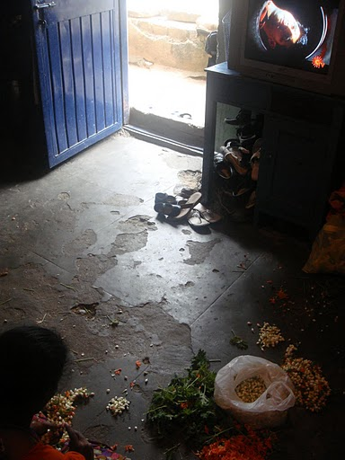
INFORMAL INCOME
Many of the mothers, since they are confined to the household for most of the day, thread flower garlands for some extra cash.
A garland seller will drop off flowers (by the kilogram) in the morning, and the women thread them and return them in the evening, before the Hindu prayers begin. They can make about 100 to 200 extra rupees by the end of the week doing this on a daily basis.

Slide 19
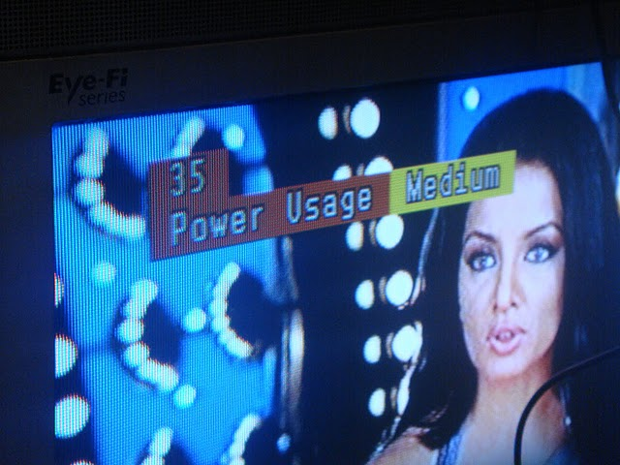
One of the most common things that families reported watching together were ‘serials’, which are basically like trashy soap operas for Indian families. Also, many mothers enjoy watching cartoons with their children, and the whole family will watch Bollywood movies and music videos together.

Slide 20
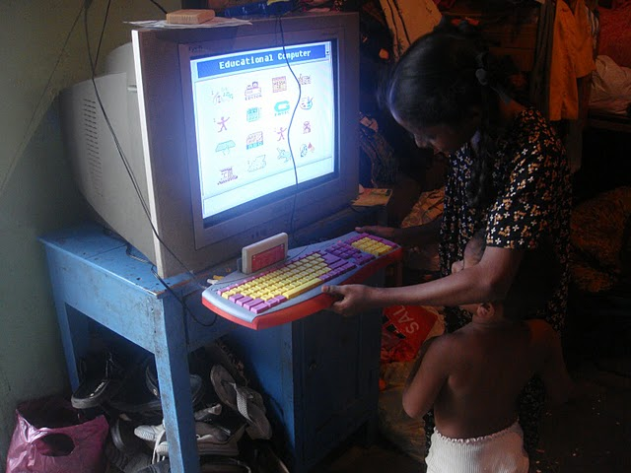
The kids preferred the ‘non-educational’ gaming cartridge, including games like Mario, skeet shooting, and galaxy
They play the ‘non-educational’ cartridge for about an hour a day, versus the ‘educational’ for about 30 minutes a day

Slide 21
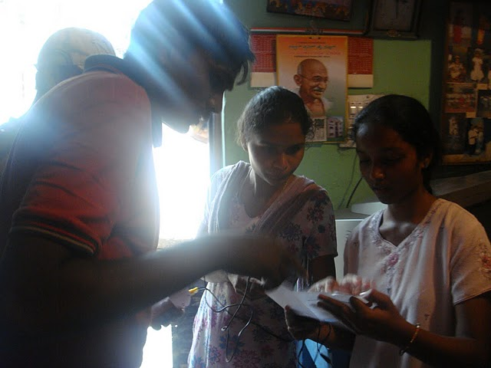
It’s pretty common for the English literacy level and/or general level of formal education to be higher in children than their parents. On the flipside, many parents can speak more languages than their children, since their neighborhoods have migrants from several regions in India.
Kid A (shown right ) has a very high level of English. Using the TVC, she was trying to teach her cousin’s son his ABCs.

Slide 22
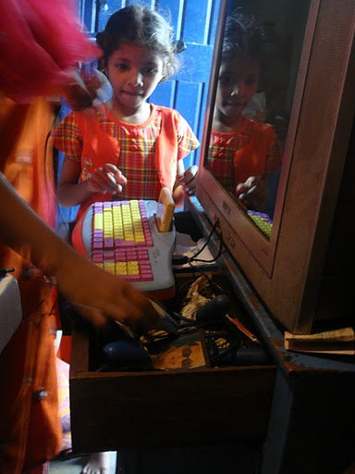
A FAMILY THAT PLAYS TOGETHER…
Initially, the father of the household talked about not really ‘playing with the kids’ at all. After we gave them the TVC, they told us they showed their dad how to use it, and he started playing with the eldest daughter and son on a daily basis, when he came back from work. He would play with his son most often, then the eldest daughter. They compete with each other for high scores and so far, the father is the record holder.
The mother tried the gun once, but was ‘too scared to break it’.
Where to put the device?

Slide 23
General Themes:
Constrained Space
Conservation Activities
Informal Incomes
Children teaching children
Syncretic religious practices
Social nature of TV watching
Intervention Themes:
Inter-generational social dynamics of video game play
Kids play the games cartridge at more than the educart
“Afraid to break it" may be a common inhibition to participate

